Slide 1
Modern Computing Architecture

Slide 2
Flynn's classification
The most popular taxonomy of computer architecture was defined by Flynn in 1966.
Flynn's classification scheme is based on the notion of a stream of information.
Two types of information flow into a processor: instructions and data.
The instruction stream is defined as the sequence of instructions.
The data stream is defined as the sequence of data and exchanged between the memory and the processing unit.

Slide 3
Flynn's classification
Instructions are decoded by the control unit and then control unit send the instructions to the processing units for execution.
Data Stream flows between the processors and memory bi directionally.
A sequential computer which exploits no parallelism in either the instruction or data streams.

Slide 4
Flynn's classification
According to Flynn's classification, either of the instruction or data streams can be single or multiple.
Computer architecture can be classified into the following four distinct categories:
Single Instruction Single Data Streams (SISD)
Single Instruction Multiple Data Streams (SIMD)
Multiple Instruction Single Data Streams (MISD)
Multiple Instruction Multiple Data Streams (MIMD)

Slide 5

Flynn's classification
Single Instruction Single Data Streams (SISD)
A serial (non-parallel) computer
Single Instruction: Only one instruction stream is being acted on by the CPU during any one clock cycle
Single Data: Only one data stream is being used as input during any one clock cycle

Slide 6
Flynn's classification
Single Instruction Single Data Streams (SISD)
This is the oldest type of computer
Examples: older generation mainframes, minicomputers, workstations and single processor/core PCs.

Slide 7
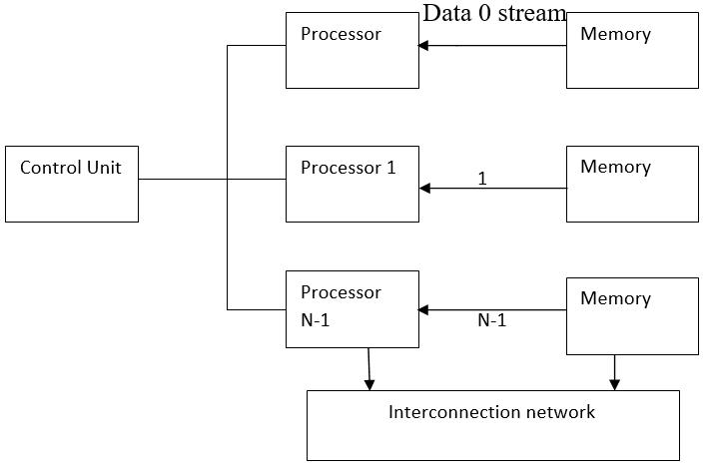
Flynn's classification
Single Instruction Multiple Data Streams (SIMD)
A type of parallel computer
Single Instruction: All processing units execute the same instruction at any given clock cycle
Multiple Data: Each processing unit can operate on a different data element

Slide 8
Flynn's classification
Single Instruction Multiple Data Streams (SIMD)
Best suited for specialized problems characterized by a high degree of regularity, such as graphics/image processing.
Two varieties: Processor Arrays and Vector Pipelines

Slide 9
Flynn's classification
Single Instruction Multiple Data Streams (SIMD)
Processor Arrays: Thinking Machines CM-2, MasPar MP-1 & MP-2, ILLIAC IV
Vector Pipelines: IBM 9000, Cray X-MP, Y-MP & C90, Fujitsu VP, NEC SX-2, Hitachi S820, ETA10
Most modern computers, particularly those with graphics processor units (GPUs) employ SIMD instructions and execution units.

Slide 10
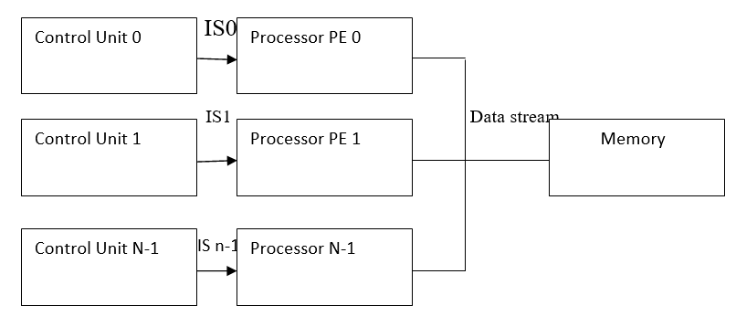
Flynn's classification
Multiple Instruction Single Data Streams (MISD)
A type of parallel computer
Multiple Instruction: Each processing unit operates on the data independently via separate instruction streams.
Single Data: A single data stream is fed into multiple processing units.

Slide 11
Flynn's classification
Multiple Instruction Single Data Streams (MISD)
Few (if any) actual examples of this class of parallel computer have ever existed.
Some conceivable uses might be:
multiple frequency filters operating on a single signal stream
multiple cryptography algorithms attempting to crack a single coded message.

Slide 12
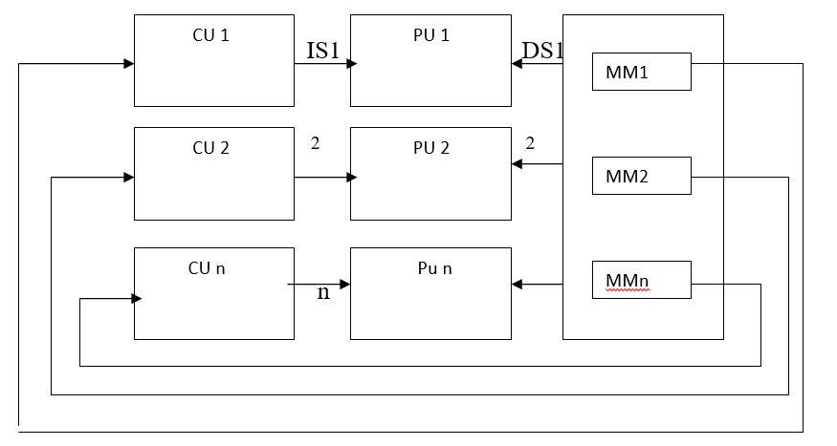
Flynn's classification
Multiple Instruction Multiple Data Streams (MIMD)
A type of parallel computer
Multiple Instruction: Every processor may be executing a different instruction stream
Multiple Data: Every processor may be working with a different data stream

Slide 13
Flynn's classification
Multiple Instruction Multiple Data Streams (MIMD)
Execution can be synchronous or asynchronous, deterministic or non-deterministic
Currently, the most common type of parallel computer - most modern supercomputers fall into this category.

Slide 14
Flynn's classification
Multiple Instruction Multiple Data Streams (MIMD)
Examples: most current supercomputers, networked parallel computer clusters and "grids", multi-processor SMP computers, multi-core PCs.
Note: many MIMD architectures also include SIMD execution sub-components

Slide 15
Flynn's classification
Parallel computers are either SIMD or MIMD

